Slide 1


Muhammad Faiz Amir Aththufail
December 12, 2022

Slide 2

Outline
Executive Summary
Introduction
Methodology
Results
Conclusion
Appendix

Slide 3
Executive Summary
The data was collected through various sources, such as SpaceX REST API and Wiki pages.
The data includes data for the Falcon 1 booster which is unnecessary for predicting the Falcon 9 launches outcome, therefore it was removed.
The PayloadMass data had some missing values, we then dealing these missing values by replacing it with the mean of PayloadMass data.
Then we visualized the data by building an interactive dashboard.
We then train machine learning models, such as Logistic Regression, Support Vector Machine, Decision Tree, and K-Nearest Neighbors and find the best hyperparameters to predict if SpaceX will reuse the first stage.
The result shows that all models perform similarly considering the similar results on the accuracy for the test data

Slide 4
Introduction
SpaceX is one of the most successful companies that are making space travel affordable for everyone. SpaceX’s accomplishments include, sending spacecraft to the International Space Station, providing satellite internet access using a satellite internet constellation called Starlink, and sending manned missions to space. One reason SapceX can do this is because SpaceX’s rockets can reuse the first stage, therefore the rocket launches are relatively inexpensive which only cost 62 million dollars compared to other companies which cost upwards of 165 million dollars.
By determining whether the first stage will land or not, we can determine the cost of a launch

Slide 5

Section 1

Slide 6
Methodology
Executive Summary
Data collection methodology:
Data was collected from various sources, such as SpaceX REST API and Wiki pages
Perform data wrangling
Landing outcomes data was processed by separating bad outcomes and successful outcomes then converting it to numerical values (0 and 1)
Perform exploratory data analysis (EDA) using visualization and SQL

Slide 7
Methodology
Executive Summary
Perform interactive visual analytics using Folium and Plotly Dash
Perform predictive analysis using classification models
Normalized the features data
Splitted data into training set and test set
Trained machine learning models using the training set
Tuned the hyperparameters and looked for the best hyperparameters
Performed the models using the test set
Calculated the accuracy score

Slide 8
Data Collection
The data was collected from the SpaceX REST API and Wiki Pages.
The data from SpaceX REST API was collected by performing HTTP GET Request to the SpaceX REST API which returns JSON format response then converting it to Data Frame
The data from Wiki Pages was collected by performing GET Request to the URL and then webscrapping it using BeautifulSoup
https://github.com/faizamir123/IIBM_Capstone

Slide 9
Data Collection – SpaceX API
Make get requests to SpaceX REST API
Retrieve data from API
Start
Present your data collection with SpaceX REST calls using key phrases and flowcharts
Add the GitHub URL of the completed SpaceX API calls notebook (must include completed code cell and outcome cell), as an external reference and peer-review purpose
Convert JSON into Data Frame
Raw Data Frame
Make get request for features that show ID to the feature’s specific API endpoint
Completed Raw Data
End

Slide 10
Data Collection - Scraping
Make get requests to wiki pages URL
HTML response
Start
Present your web scraping process using key phrases and flowcharts
Add the GitHub URL of the completed web scraping notebook, as an external reference and peer-review purpose
Create BeautifulSoup Object and parse the HTML file
HTML contents
Extract HTML table and convert it to Data Frame
Completed Raw Data
End

Slide 11
Data Wrangling
The collected data has some features that need to be processed, for example the column feature Outcome which has to be grouped between the bad outcome and successful outcome.
Bad outcomes include False ASDS, False Ocean, False RTLS, None ASDS, None None
Successful outcomes include True ASDS, True RTLS, and True Ocean
Make dummy variables to convert categorical features like orbits, launch site, landing pad, and serial
https://github.com/faizamir123/IIBM_Capstone
Group the feature Outcome based on bad and successful outcome
Collected Data
Start
Convert categorical values to numerical values
(0 for bad outcomes and 1 for successful outcomes)
Convert categorical values to numerical values
(by using dummy variables and converting false/true values to 0 and 1)
Processed Data
End

Slide 12
EDA with Data Visualization
Scatter Plot: to see the relationship between two features
Bar Chart: to visualize the frequency (in this case the success rate) of a feature
Line Chart: to visualize the trend over the time
https://github.com/faizamir123/IIBM_Capstone

Slide 13
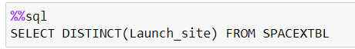
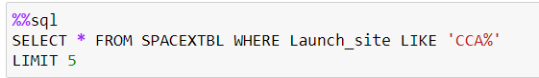
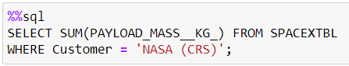
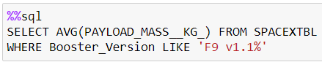
EDA with SQL
Using SELECT DISTINCT statement to display the name of unique launch sites
Using WHERE clause and LIKE clause to filter launch sites begin with CCA
Using SUM function to display the total Payload Mass and filter the customer to NASA (CRS)
Using AVG function to display the average Payload Mass and filter the booster version that begin with F9 v1.1
Using where to choose only the successful landing outcome, substr function to extract the date and MIN function to find the first successful landing outcome

Slide 14
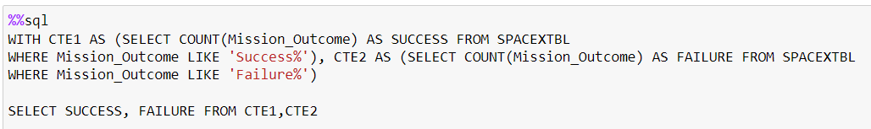
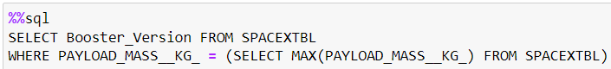
EDA with SQL
Display the name of the booster version and using WHERE clause to filter the boosters which have success in drone ship and have Payload Mass greater than 4000 but less than 6000
Using Common Table Expressions to display the total number of successful and failure missions outcomes
Using a subquery and MAX function to list the names of the booster versions which have carried the maximum Payload Mass

Slide 15
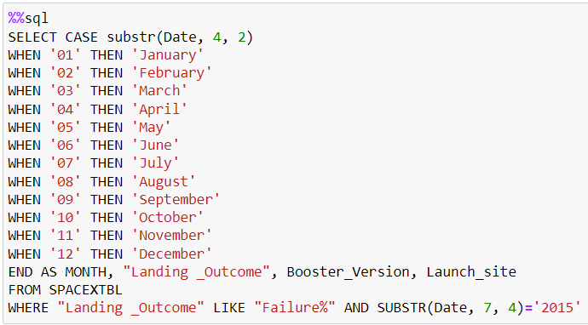
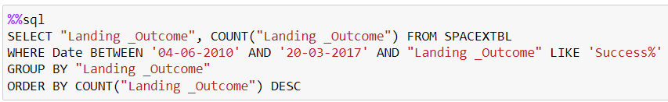
EDA with SQL
Using substr function to extract the months and year and using CASE to convert the month number to month name then display the month names, failure landing outcomes in drone ship, booster version, and launch site for months in year 2015
Using COUNT function and WHERE clause to count the successful landing outcomes between the date 04-06-2010 and 20-03-2017, using GROUP BY to group the data based on landing outcomes, and using ORDER BY to rank it in descending order

Slide 16
Build an Interactive Map with Folium
Marker objects are added to folium map to mark all the launch sites’ locations
Circle objects are added to folium map to mark the area of the launch sites’ locations
Marker Cluster objects are used to cluster/group the number of events that occurred in a certain area in this case success/failed launches for each site
Line objects are used to show distances between a launch site to its proximities
https://github.com/faizamir123/IIBM_Capstone

Slide 17
Build a Dashboard with Plotly Dash
There are two types of plots that have been added to the dashboard, pie chart and scatter plot
Pie charts are used to show the proportion of the number of successful launches between launch sites and the proportion of successful and failed launches on each site
Scatter plots are used to show the relationship between Payload Mass and the outcome of the launches
https://github.com/faizamir123/IIBM_Capstone

Slide 18
Predictive Analysis (Classification)
Processed Data
Standardize the feature’s columns
Start
Standardize the feature’s columns using standardscaler
Split the data into training and test set
Standardized data
Split data into training and test set
Using GridSearch CV to train models and find the best parameters
Splitted Data
P1

Slide 19
Predictive Analysis (Classification)
P1
Trained Models
Use the models onto the test set
Using GridSearchCV to automate the process of training models and finding the best parameters and hyperparameters for each model
Calculate the accuracy score on the test set
Display the confusion matrix
Calculate the accuracy score
Accuracy score
Confusion Matrix
Display the confusion matrix
End

Slide 20
Results
Exploratory data analysis results
Interactive analytics demo in screenshots
Predictive analysis results

Slide 21

Section 2

Slide 22
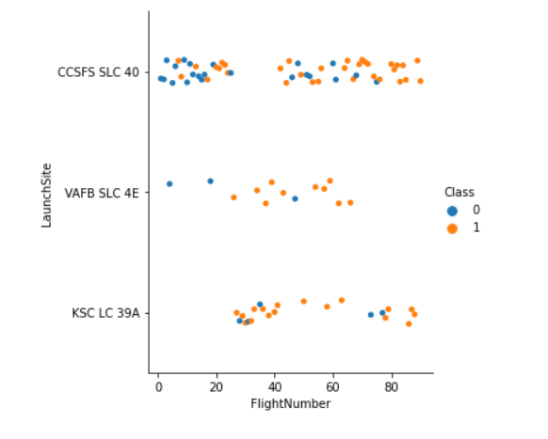
Flight Number vs. Launch Site
On each launch sites as the flight number increases, the first stage is more likely to land successfully.
Many launches took place in CCSFS SLC 40 launch site

Slide 23
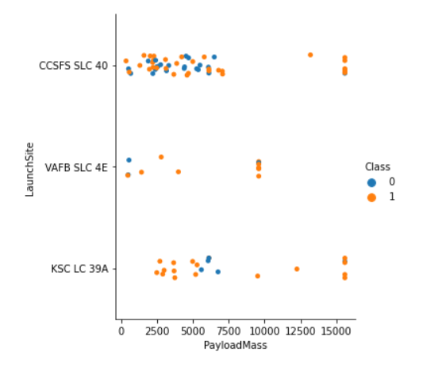
Payload vs. Launch Site
There are no rockets launched for heavypayload mass (greater than 10000) for the VAFB-SLC 4E launch site.
The rockets with payload greater than 7500 are more likely to land the first stage successfully

Slide 24
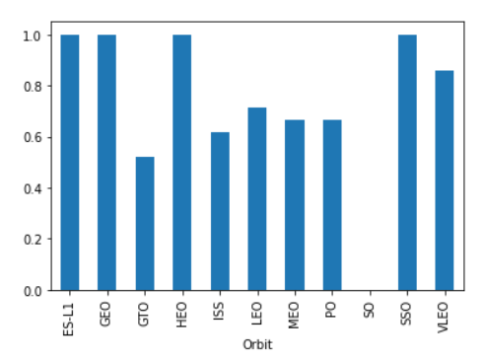
Success Rate vs. Orbit Type
The orbit ES-L1, GEO, HEO, and SSO have the highest successful rate, which is 1
Whereas the orbit with the lowest successful rate is SO, with the successful rate of 0

Slide 25
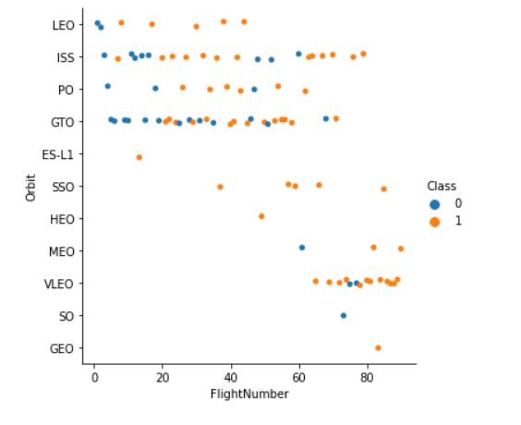
Flight Number vs. Orbit Type
There seems to be no relationship between flight number in GTO orbit
In LEO and PO orbit the success appears to be related to the flight number, as the flight number increases, the first stage is more likely to land successfully

Slide 26
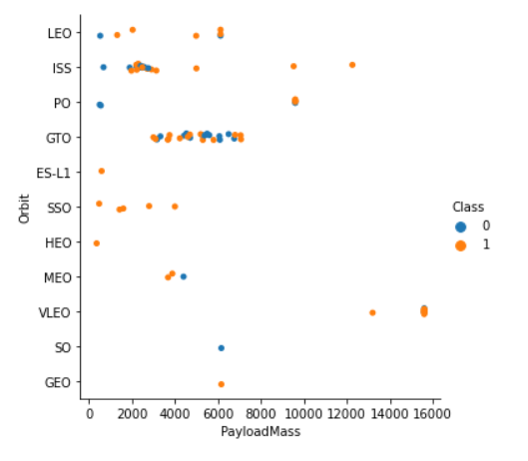
Payload vs. Orbit Type
With heavier payload mass, the first stage is more likely to land successfully for LEO, ISS, and PO orbit.
However, we couldn’t distinguish the relationship for GTO orbit

Slide 27
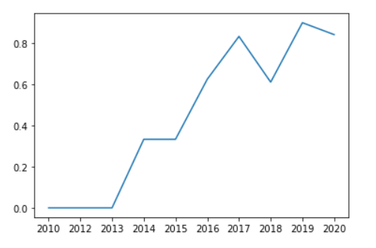
Launch Success Yearly Trend
The success rate kept increasing from 2013 through 2020, although there was a slight decrease in 2018, but overall the success rate kept increasing

Slide 28
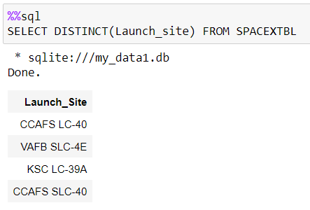
All Launch Site Names
Using DISTINCT function, we return the names of the unique launch sites

Slide 29
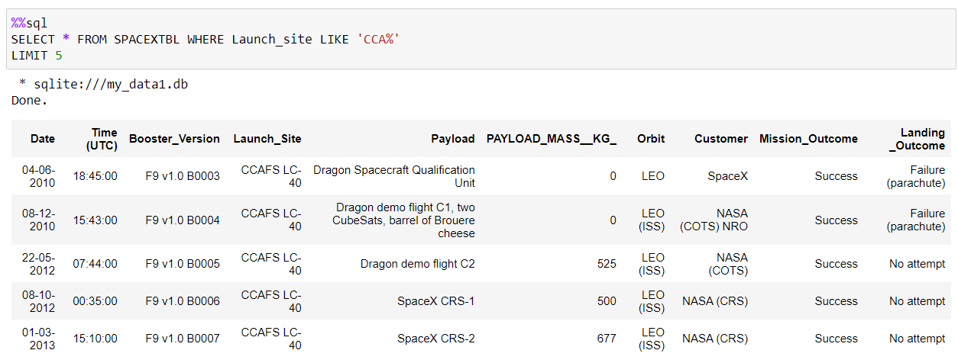
Launch Site Names Begin with 'CCA'
Using WHERE clause and LIKE clause, we filter the launch sites with the name begin with CCA and display only the first 5 records using LIMIT clause

Slide 30
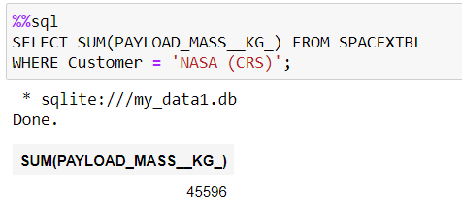
Total Payload Mass
Using the WHERE clause we filter the customer to NASA (CRS) and we calculate the total payload mass using the SUM function

Slide 31
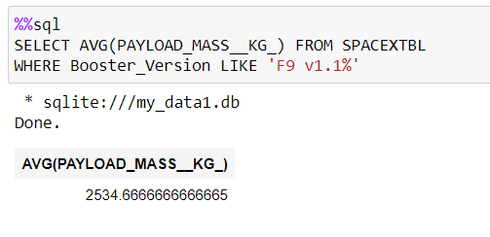
Average Payload Mass by F9 v1.1
Using the WHERE and LIKE clause we filter the booster version that start with F9 v1.1
Using the AVG function we calculate the average payload mass carried by booster version F9 v1.1

Slide 32
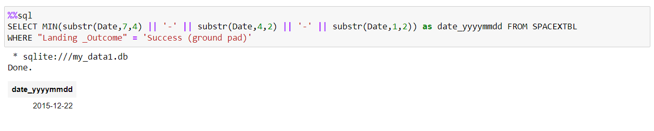
First Successful Ground Landing Date
We extract the date using substr function
Using WHERE clause we filter the landing outcome so we have the success landing in ground pad
Using MIN function we search for the first record of the successful landing outcome in ground pad

Slide 33
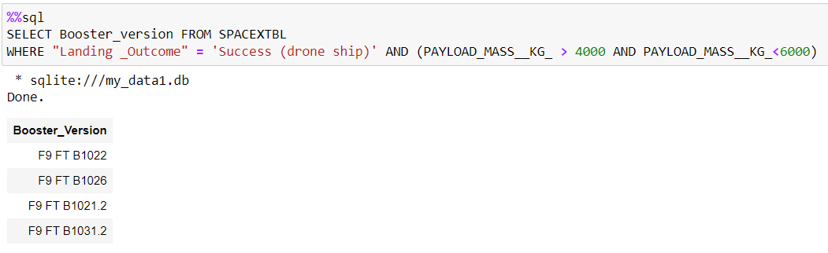
Successful Drone Ship Landing with Payload between 4000 and 6000
Using WHERE clause we filter the landing outcome to Success (drone ship) and payloadmass greater than 4000 and less than 6000
We obtain the list of booster versions that land successfully in drone ship and have payload mass greater than 4000 but less than 6000

Slide 34
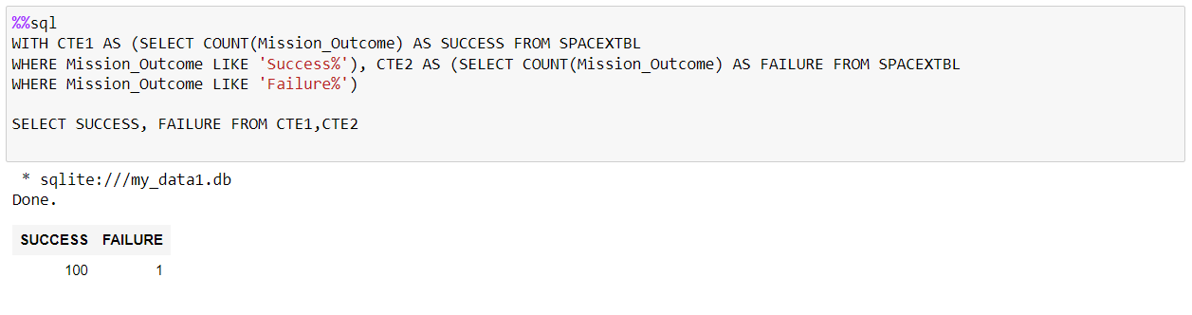
Total Number of Successful and Failure Mission Outcomes
Using Common Table Expressions (CTE), we return the number of successful and failure mission outcome

Slide 35
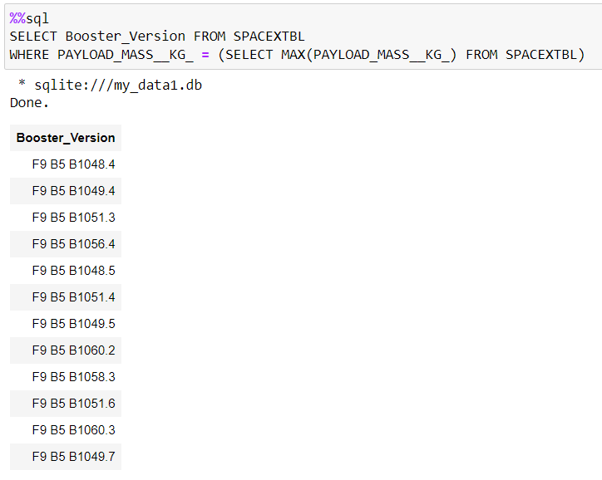
Boosters Carried Maximum Payload
Using a subquery we are able to use MAX function inside WHERE clause to search for the names of the booster versions which have carried the maximum payload mass

Slide 36
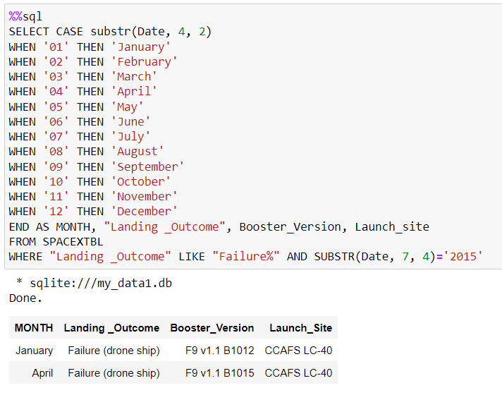
2015 Launch Records
Using CASE we assign the month name to the month number
Using WHERE clause we filter the landing outcome so it returns the failure landing in drone ship at 2015
We display the record list containing the month name, landing outcome, booster version, and launch site

Slide 37
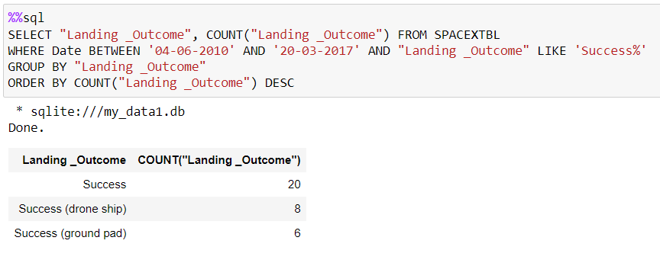
Rank Landing Outcomes Between 2010-06-04 and 2017-03-20
Using the COUNT function we return the number of landing outcome
We filter the data using WHERE and BETWEEN clause so it return the result between the given date range
Using GROUP BY, we group the result based on the landing outcome
We order the count data descending uasing ORDER BY and DESC, so it return the rank of landing outcomes

Slide 38

Section 3

Slide 39
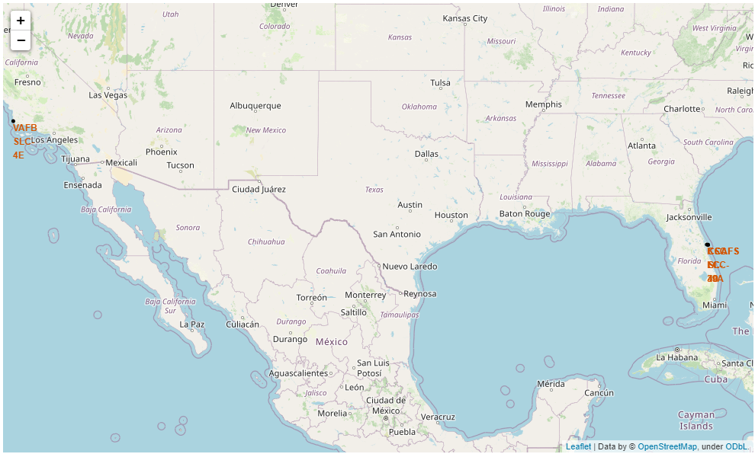
Launch Sites Location
As we can see in the following picture the launch sites are located near the coastline
This could be because it is safer to launch the rockets to the sea

Slide 40
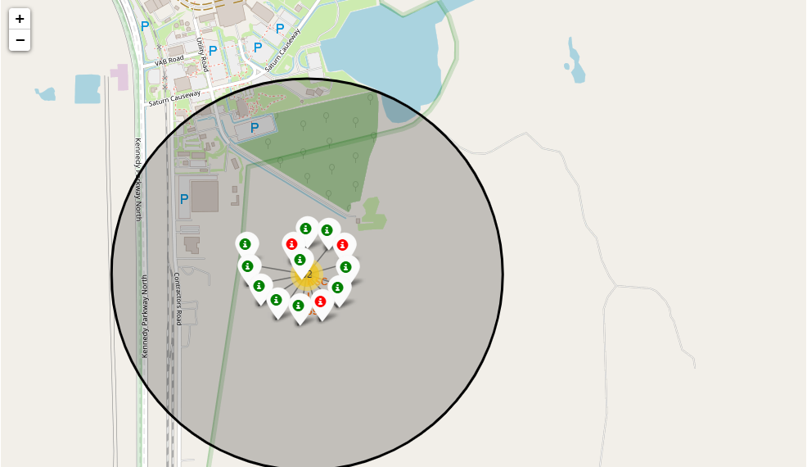
Launch Outcomes
We could see that the color red represent the failed launch outcomes, whereas the color green represent the successful launch outcomes
The following picture is an example of launch outcomes in KSC LC-39A launch site
The launch site KSC LC-39A have a pretty high successful launch outcome rate

Slide 41
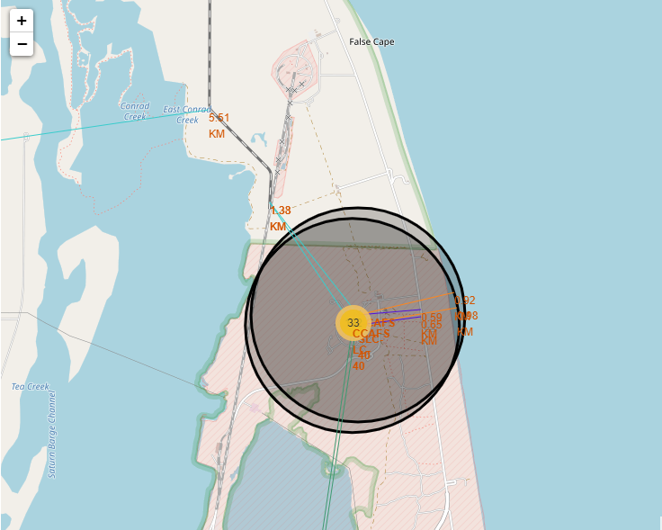
Distance Between Launch Sites to its Proximities
The following picture shows the distance between launch site and its proximities such as the closest coastline, city, railway and highway.
The distance between launch site and the closest coastline is represented by the orange line
The distance between launch site and the closest railway is represented by the cyan line
The distance between launch site and the closest highway is represented by the purple line
The distance between launch site and the closest city is represented bby the green line

Slide 42

Section 4

Slide 43
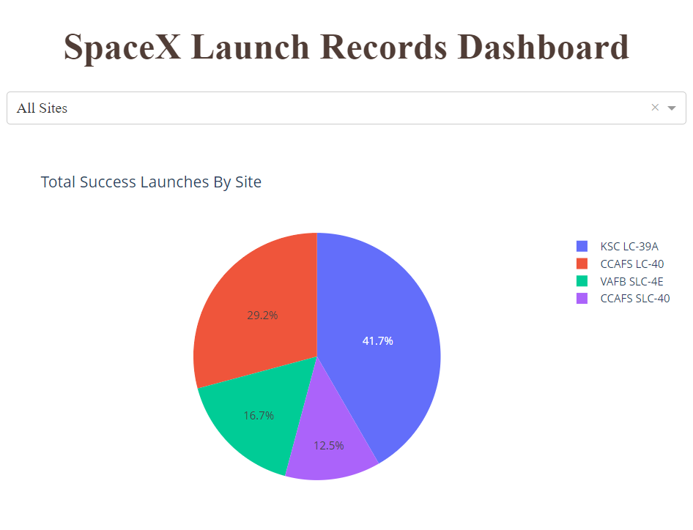
Total Success Launches By Site
The given pie chart tells us that the launch site KSC LC-39A have the highest number of successful launches followed by CCAFS LC-40, VAFB SLC-4E, and the last is CCAFS SLC-40

Slide 44
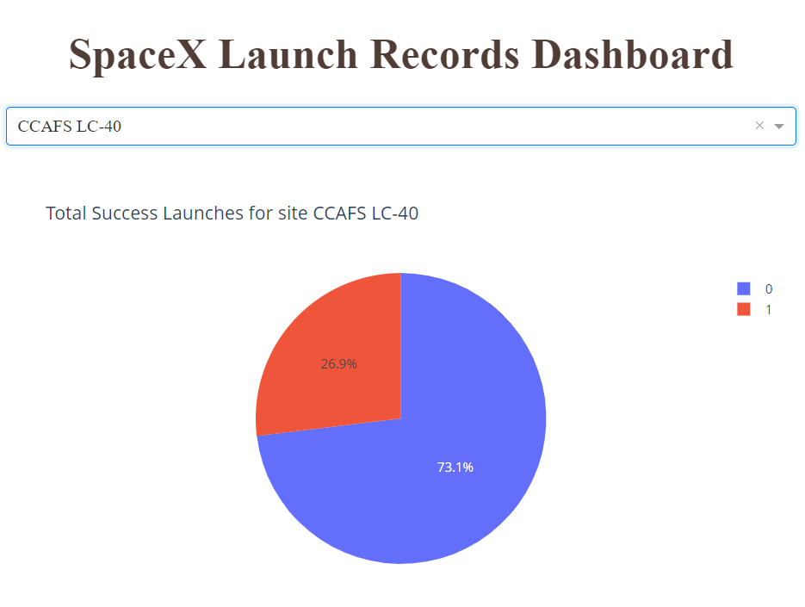
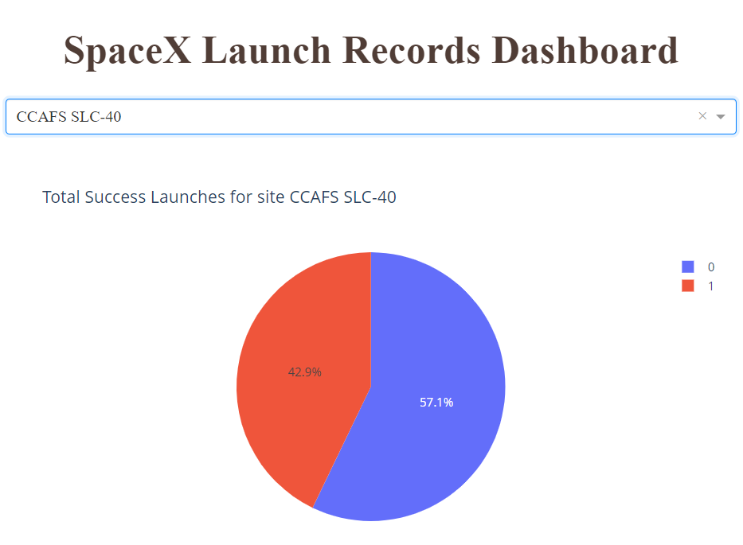
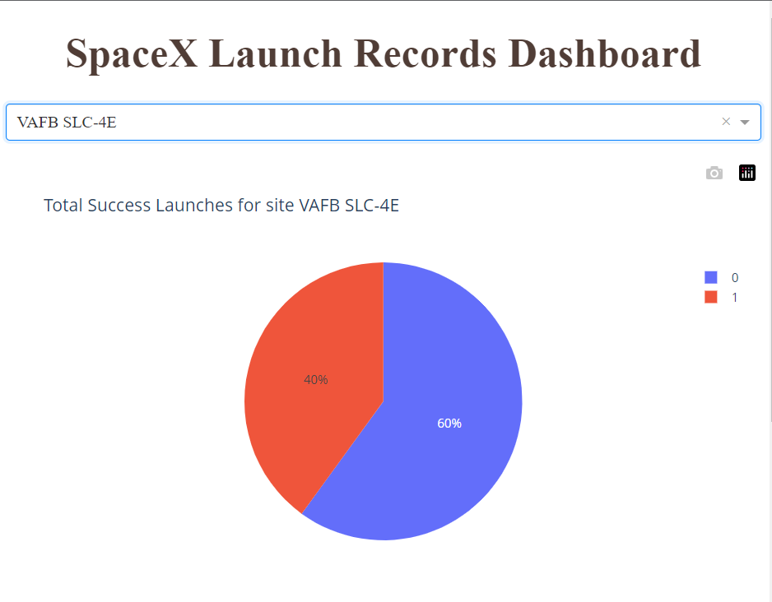
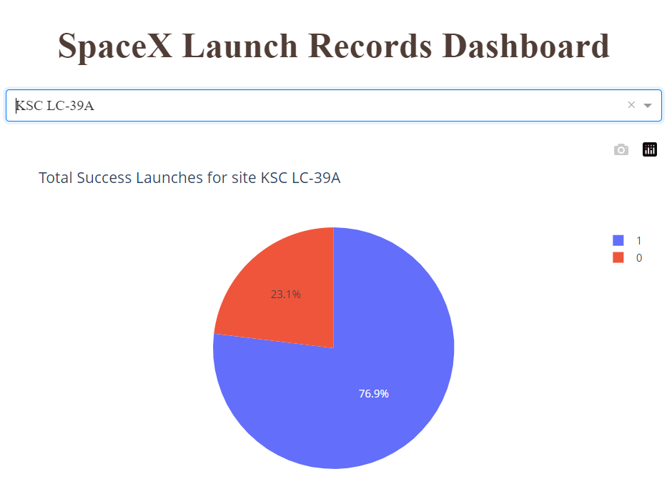
<Dashboard Screenshot 2>
From the following pie charts we can see that launch site KSC LC-39A have the highest successful launch outcomes ratio with the ratio of 76.9%

Slide 45
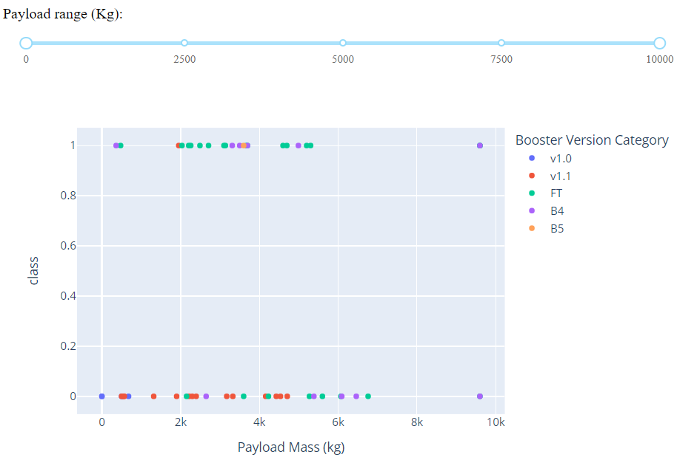
Payload vs. Launch Outcome scatter plot for All Sites
Based on the following scatter plot about payload vs. Launch Outcome for all sites, we can see that the booster version FT with the payload mass between 2000 until 6000 kg have the highest successful rate
Whereas the booster version v1.1 with the payload mass between 0 until 6000 have the lowest successful rate

Slide 46

Section 5

Slide 47
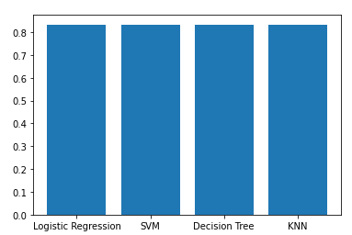
Classification Accuracy
We could see from the following bar chart that all models have similar accuracy score which tell us that all models perform similarly

Slide 48
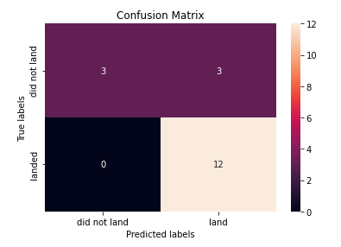
Confusion Matrix
All models produce the same confusion matrix. From the confusion matrix we could see that the models can predict accurately the landed outcomes, but for the unsuccessful outcomes the models still couldn’t predict the result accurately.

Slide 49
Conclusions
We performed predictive analysis using logistic regression, support vector machine, decision tree, and K Nearest Neighbor
All models performed similarly and have similar accuracy score

Slide 50
Appendix
https://github.com/faizamir123/IIBM_Capstone

Slide 51


